Slide 1
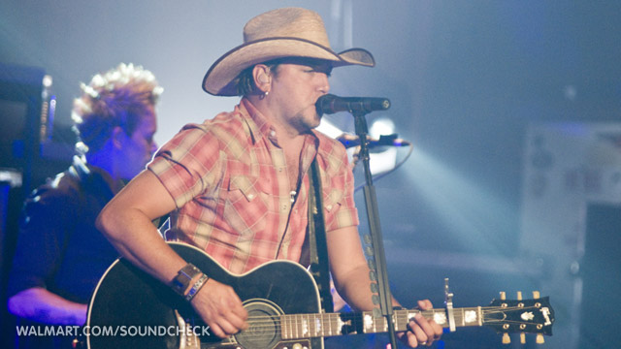
Dirt Road Anthem
Slide by: Carter Nichols, Song By: Jason Aldean

Slide 2
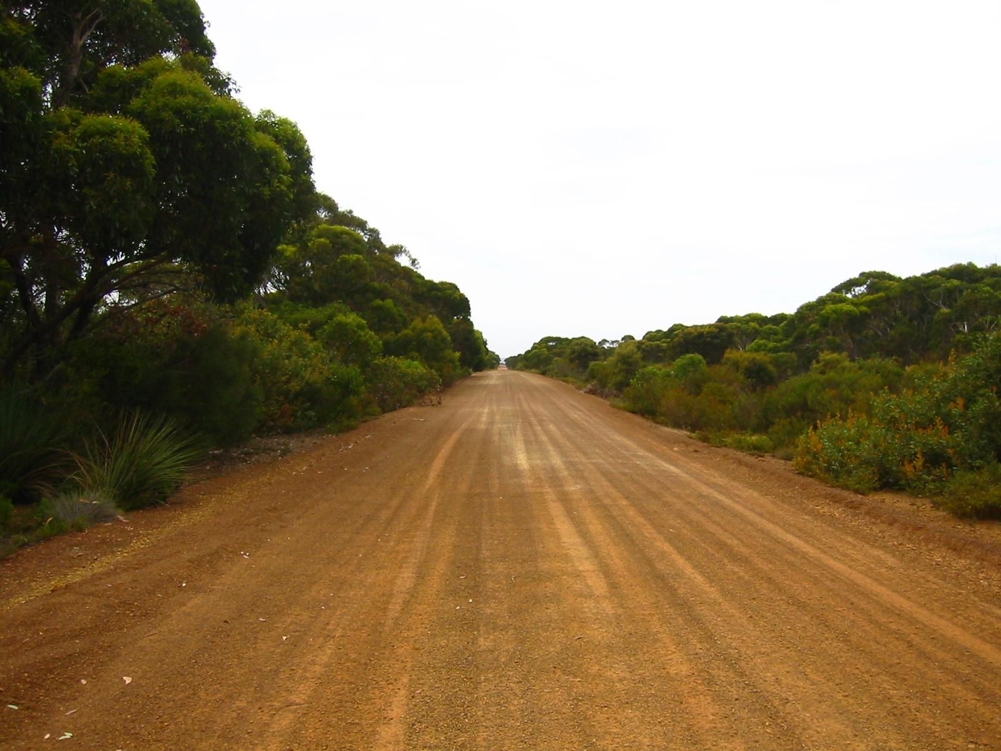
Lyrics
Yeah I’m chillin’ on a dirt road
Laid back swervin’ like I’m George Jones
Smoke rollin’ out the window
An ice cold beer sittin’ in the console
Memory lane up in the headlights
Its got me reminiscing on them good times

Slide 3
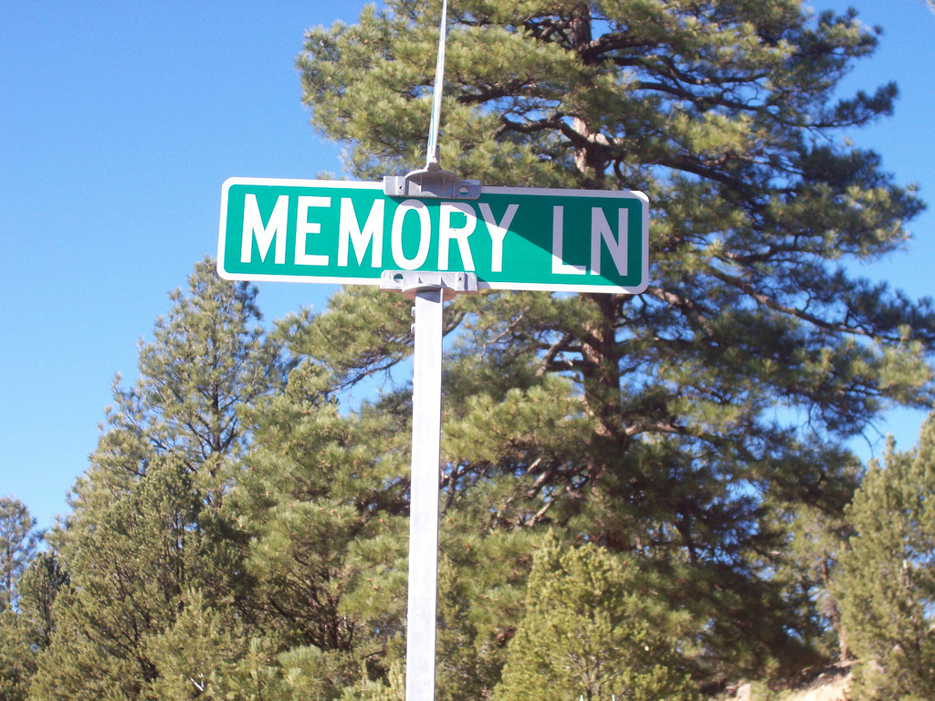
Lyrics
I’m turnin’ off of real life drive and that’s right
I’m hittin’ easy street on mud tires
Back in the day Potts farm was the place to go
Load the truck up, hit the dirt road
Jump the barbed wire, spread the word
Light the bonfire then call the girls

Slide 4
Lyrics
King in the can and the Marlboro man
Jack n’ Jim were a few good men
Where you learn to kiss and cuss and fight too
Better watch out for the boys in blue
And, all this small town he said, she said
Ain’t it funny how rumors spread?

Slide 5
Lyrics
Like I know somethin’ y’all don’t know
man that talk is gettin’ old
You better mind your business man,
Watch your mouth
Before I have to knock that loud mouth out
I’m tired of talkin’ man y’all ain’t listenin’

Slide 6
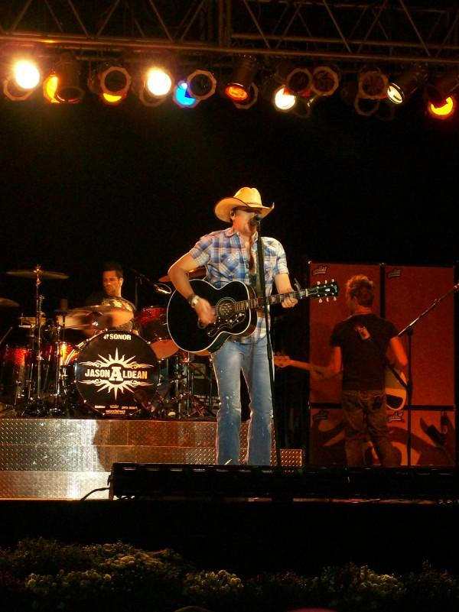
Lyrics
Them ol’ dirt roads, is what y’all missin’
Yeah I’m chillin’ on a dirt road
Laid back swervin’ like I’m George Jones
Smoke rollin’ out the window
an ice cold beer sittin’ in the console
Memory lane up in the headlights

Slide 7
Lyrics... Again
Its got me reminiscing on them good times
I’m turnin’ of of real life drive and that’s right
I’m hittin’ easy street on mud tires
I sit back and think about them good old days
The way we were raised in our southern ways
And we like cornbread and biscuits

Slide 8
Lyrics...
And if it’s broke ‘round here we fix it
I can take y’all where you need to go
Down to my hood, Back in them woods
We do it different ‘round here that’s right
But we sure do it good and we do it all night
So if you really want to know how it feels

Slide 9
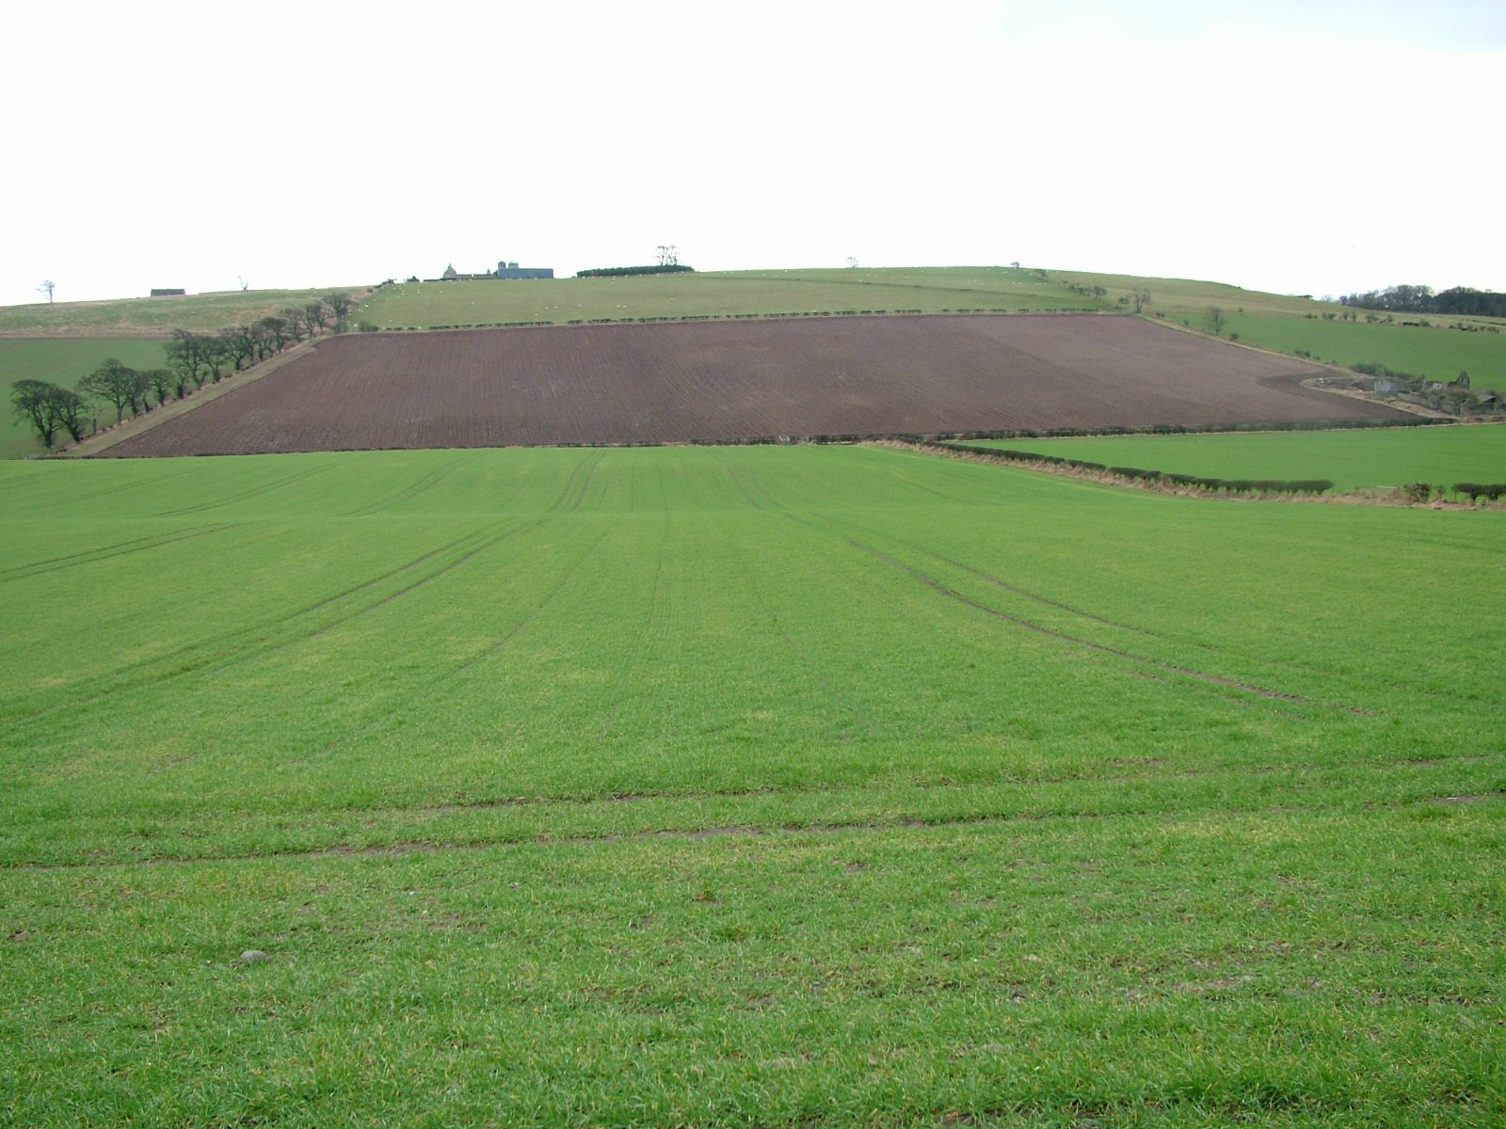
More Lyrics
To get off the road with trucks and four wheels
Jump on in and man tell your friends
We’ll raise some **beep** where the black top ends
Yeah I’m chillin’ in a dirt road
Laid back swervin’ like I’m George Jones
Smoke blowin’ out the window

Slide 10

Even more Lyrics… why just… why
An ice cold beer sittin’ in the console
Memory lane up in the headlights
It’s got me reminiscing on them good times
I’m turnin’ off of real life drive and that’s right
I’m hittin’ easy street on mud tires
Let’s ride

Slide 11

You will not die reading these Lyrics
Yeah I’m chillin’ on a dirt road
Laid back swervin’ like I’m George Jones
Smoke blowin’ out the window
An ice cold beer sittin’ in the console
Memory lane up in the headlights
It’s got me reminiscin’ on them good times

Slide 12

Almost done with the Lyrics
I’m turnin’ off of real life drive and that’s right
I’m hittin’ easy street on mud tires
Let’s ride

Slide 13


Simile
The verse “Laid back swervin’ like I’m George Jones”
The reason is because I don’t know George Jones,and he isn’t Jones Because he is Jason Aldean.

Slide 14

Idiom
When he says “Before I have to knock that loud mouth out” he really you can’t knock out someone’s mouth … you must be the Hulk.!!!!!!! And it means that he will probably hurt him… punch him maybe.

Slide 15
Personification
When it says “An ice cold beer sittin’ in the console” it means it’s in the console. Liquid can’t sit… it flows.

Slide 16
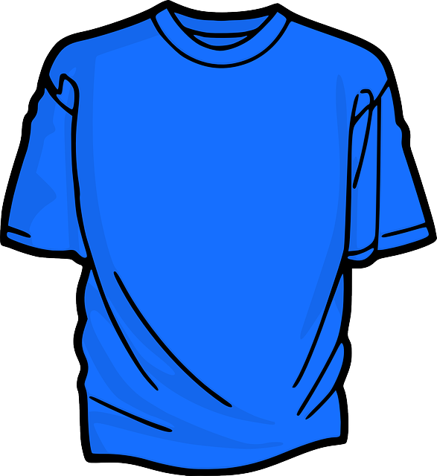
Alliteration
In this song the verse “Better watch out for the boys in blue” Better, boys and blue all start with the same letter.

